Slide 1



Music Machine Learning
X – Data complexity - GPU Computing
Master ATIAM - Informatique
Philippe Esling (esling@ircam.fr)
Maître de conférences – UPMC
Equipe représentations musicales (IRCAM, Paris)

Slide 2
Any type of audio recognition
Up to now we have seen classification
Each working on a specific problem
But on which features ?
Years of research on audio features

Slide 3
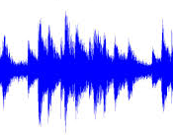
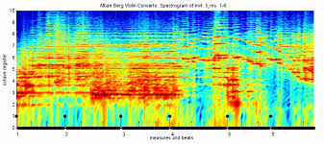

Audio features

Slide 4
Retrieving musical information (MIR)
Harmonic analysis
Pitch tracking, melody estimation
Multiple F0 estimation, chord estimation
Rhythmic analysis
Onset detection
Tempo estimation, beat tracking
Content-based analysis
Instrument recognition
Structure analysis
Classification (genre recognition, tags, mood, …)
Music similarity and cover detection
Query by content (query by humming)

Slide 5
Known issues of machine learning
Overfitting / Overtraining
(function approximation)
Curse of dimensionnality
(dimensionnality reduction)
Cross-validation
(generalization probability)
Cherry picking
(datasets discrepancies)
The No Free Lunch theorem
(overall accuracy)

Slide 6
Defining Machine Learning

Slide 7
Defining Machine Learning

Slide 8
Defining Machine Learning

Slide 9
Defining Machine Learning

Slide 10
Defining Machine Learning

Slide 11
Defining Machine Learning

Slide 12
Defining Machine Learning

Slide 13
Defining Machine Learning

Slide 14
Defining Machine Learning

Slide 15
Defining Machine Learning

Slide 16
Defining Machine Learning

Slide 17
Defining Machine Learning

Slide 18
Defining Machine Learning

Slide 19
Markov Chains

Slide 20
Choosing the right function

Slide 21
Cross-validation

Slide 22
Cross-validation

Slide 23
Knowing when to stop
Early stopping
Stop the learning when the error increases on the validation set
(Approximates the generalization power)
Underfitting
Overfitting
Validation
Training

Slide 24
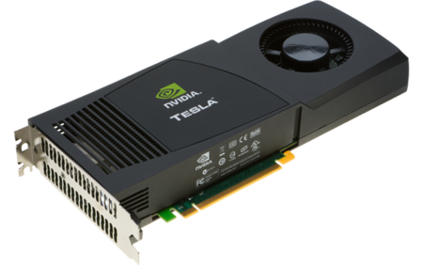
GPU Computing

Slide 25
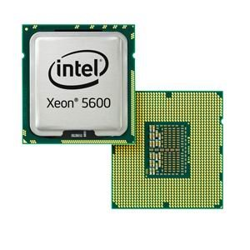
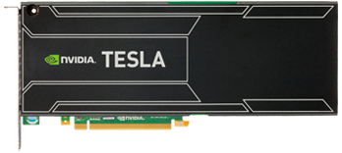
GPU Computing
CPU
GPU
CPUs consist of a few cores optimized for serial processing
GPUs consist of thousands of smaller cores for parallel processing

Slide 26
GPU Computing
CPU
GPU
CPUs consist of a few cores optimized for serial processing
GPUs consist of thousands of smaller cores for parallel processing
Intel Xeon X5650:
Clock speed: 2.66 GHz
4/cycle CPU - 6 cores
= 63.84 Gigaflops double precision
NVIDIA Tesla M2070:
Core clock: 1.15GHz
1/cycle - 448 CUDA cores
= 515 Gigaflops double precision

Slide 27
GPU Computing
CPU
GPU
CPUs consist of a few cores optimized for serial processing
GPUs consist of thousands of smaller cores for parallel processing
Intel Xeon X5650:
Clock speed: 2.66 GHz
4/cycle CPU - 6 cores
= 63.84 Gigaflops double precision
Memory size: 288 GB
Bandwidth: 32 GB/sec
NVIDIA Tesla M2070:
Core clock: 1.15GHz
1/cycle - 448 CUDA cores
= 515 Gigaflops double precision
Memory size: 3GB total
Bandwidth: 150 GB/sec

Slide 28
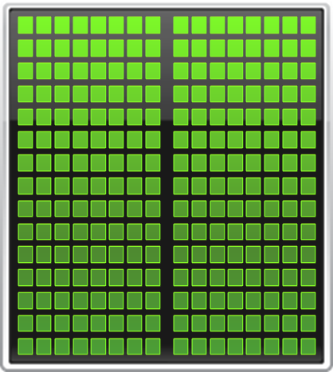


Small changes, big speed-up
Application Code
Rest of Sequential
CPU Code
GPU
Compute-Intensive Functions
CPU
Use GPU to Parallelize
+

Slide 29
Fastest performance for learning
Tesla K20X Speed-Up over Sandy Bridge CPUs
Engineering
Physics
Earth
Science
Molecular
Dynamics

Slide 30
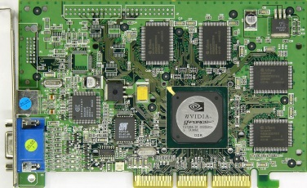
Definition of a GPU
GPU – graphics processing unit
Originally designed as a graphics processor
Nvidia's GeForce 256 (1999) – first GPU
single-chip processor for mathematically-intensive tasks
transforms of vertices and polygons
lighting
polygon clipping
texture mapping
polygon rendering

Slide 31
How to use GPUs ?
GPU Acceleration
Applications
GPU-accelerated libraries
OpenACC Directives
Programming Languages
cuFFT, cuBLAS, Thrust, NPP, IMSL, CULA, cuRAND, etc.
PGI Accelerator
C/C++, Fortran, Python, Java, etc.

Slide 32
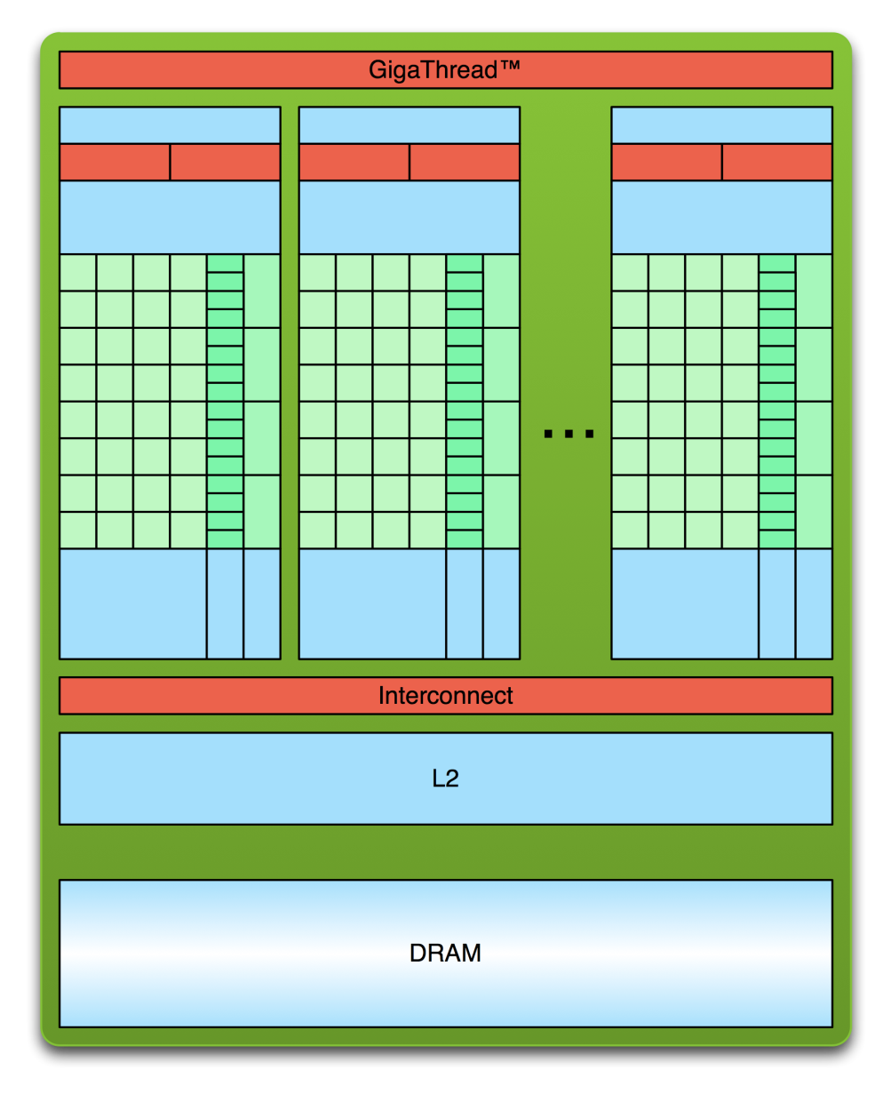
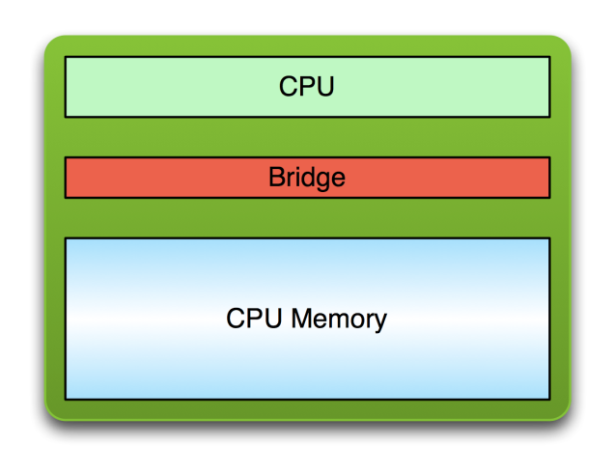
Usual processing flow
PCI Bus
Copy input data from CPU memory to GPU memory

Slide 33
Usual processing flow
PCI Bus
Copy input data from CPU memory to GPU memory
Load GPU program and execute, caching data on chip for performance

Slide 34
Usual processing flow
PCI Bus
Copy input data from CPU memory to GPU memory
Load GPU program and execute, caching data on chip for performance
Copy results from GPU memory to CPU memory

Slide 35
Software architecture
CUDA: Compute Unified Device Architecture
Applications ( e.g. Matlab )
CUDA C/C++
NVCC Compiler + Utilities ( nvprof, visual profiler )
PTX: Parallel Thread eXecution Assembly Language
( Virtual Machine )
CUBIN( Cuda Binary )
CUDA Libraries
CUDA Runtime API
CUDA Driver
Operating System ( Linux, Windows, etc.)
GPU card(s) & System Board with CPU, Buses ( PCIe ),..

Slide 36
MATLAB GPU Toolbox (CUDA)
Use GPUs with MATLAB through Parallel Computing Toolbox
GPU-enabled MATLAB functions such as fft, filter, and several linear algebra operations
GPU-enabled functions in toolboxes
CUDA kernel integration in MATLAB applications, using only a single line of MATLAB code
A=rand(2^16,1);
B=fft(A);
A=gpuArray(rand(2^16,1));
B=fft(A);

Slide 37
GPU Acceleration in MATLAB
Build-in functions
many Matlab functions support GPU acceleration natively
arrayfun
specific element-wise processing
CUDA kernels
write “.cu” files
compile to “.ptx” (parallel thread execution)
run using feval

Slide 38
MATLAB GPU Toolbox (CUDA)
gpuDevice(#)
gpuDeviceCount()
reset(gpuDevice(#))
wait()
bsxfun()
gpuArray()
gather()
arrayfun()
existsOnGPU()
parallel.gpu.CUDAKernel()
feval
setConstantMemory
Many GPU enabled built-in functions: e.g. fft, …. Check with:
methods(‘gpuArray’)

Slide 39
Basic usage
Send data to GPU
either allocate there or transfer from workspace
Function gpuArray()
Run Matlab functions
GPU acceleration is used automatically
(cf. Matlab documentation)
Retrieve the output data
Function gather()

Slide 40
GPUArray class
parallel.gpu.GPUArray
main data class for GPU computations
stored in the GPU memory
create directly using static methods
copy from existing data
gpuArray(img)
zeros | nan | eye | rand | linspace
ones | true | colon | randi | logspace
inf | false |  | randn

Slide 41
GPUArray class
Supported data types:
(u)int8, (u)int16, (u)int32, (u)int64, single, double, logical
determine the type using
classUnderlying(gpuVar)
Retrieve the data using
workspaceVar = gather(gpuVar)

Slide 42
Simple example (linear)
Solve system of linear equations (Ax = b)
A = gpuArray(A);
b = gpuArray(b);
x = A\b;
x = gather(x);

Slide 43
Simple example (convolution)
M = fft2(msk);
Compute convolution using FFT
img = gpuArray(img);
msk = padarray(msk,size(img)-size(msk),0,'post');
msk = gpuArray(msk);
I = fft2(img);
M = fft2(msk,size(img,1),size(img,2));
res = real(ifft2(I.*M));
res = gather(res);

Slide 44
Linear system solution

Slide 45
GPU Acceleration in MATLAB

Slide 46
GPU Computing – CUDA in C/C++
Programming language extension to C/C++
Designed for efficient general purpose computation on GPU.
__global__ void kernel(float* x, float* y, float* z, int n){
int idx= blockIdx.x * blockDim.x + threadIdx.x;
if(idx < n) z[idx] = x[idx] * y[idx];
}
int main(){
...
cudaMalloc(...);
cudaMemcpy(...);
kernel <<<num_blocks, block_size>>> (...);
cudaMemcpy(...);
cudaFree(...);
...
}

Slide 47

Hello world
int main(void) {
printf("Hello World!\n");
return 0;
}
Standard C that runs on the host
NVIDIA compiler (nvcc) can be used to compile programs with no device code
Output:
$ nvcc hello_world.cu
$ a.out
Hello World!
$

Slide 48
Hello world
__global__ void mykernel(void) {
}
int main(void) {
mykernel<<<1,1>>>();
printf("Hello World!\n");
return 0;
}
Two new syntactic elements…

Slide 49
Hello world
__global__ void mykernel(void) {
}
CUDA C/C++ keyword __global__ indicates a function that:
Runs on the device
Is called from host code
nvcc separates source code into host and device components
Device functions (e.g. mykernel()) processed by NVIDIA compiler
Host functions (e.g. main()) processed by standard host compiler
gcc, cl.exe

Slide 50
Hello world
mykernel<<<1,1>>>();
Triple angle brackets mark a call from host code to device code
Also called a “kernel launch”
We’ll return to the parameters (1,1) in a moment
That’s all that is required to execute a function on the GPU!

Slide 51
Hello world
__global__ void mykernel(void){
}
int main(void) {
mykernel<<<1,1>>>();
printf("Hello World!\n");
return 0;
}
mykernel() does nothing, somewhat anticlimactic!
Output:
$ nvcc hello.cu
$ a.out
Hello World!
$

Slide 52
Parallel programming
But wait… GPU computing is about massive parallelism!
We need a more interesting example…
We’ll start by adding two integers and build up to vector addition
a
b
c

Slide 53
Addition on device
A simple kernel to add two integers
__global__ void add(int *a, int *b, int *c) {
*c = *a + *b;
}
As before __global__ is a CUDA C/C++ keyword meaning
add() will execute on the device
add() will be called from the host

Slide 54
Addition on device
Note that we use pointers for the variables
__global__ void add(int *a, int *b, int *c) {
*c = *a + *b;
}
add() runs on the device, so a, b and c must point to device memory
We need to allocate memory on the GPU

Slide 55
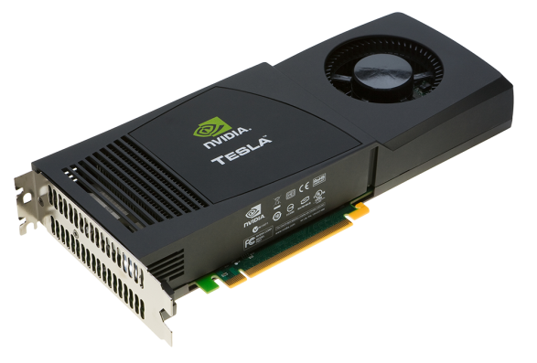
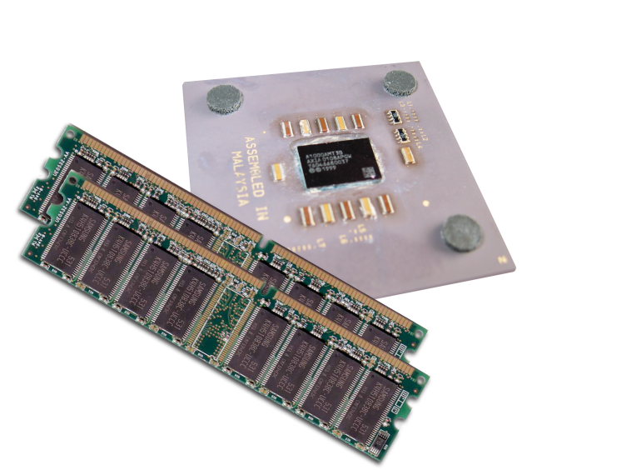
Memory management
Host and device memory are separate entities
Device pointers point to GPU memory
May be passed to/from host code
May not be dereferenced in host code
Host pointers point to CPU memory
May be passed to/from device code
May not be dereferenced in device code
Simple CUDA API for handling device memory
cudaMalloc(), cudaFree(), cudaMemcpy()
Similar to the C equivalents malloc(), free(), memcpy()

Slide 56
Addition on device
Returning to our add() kernel
__global__ void add(int *a, int *b, int *c) {
*c = *a + *b;
}
Let’s take a look at main()…

Slide 57
Addition on device
int main(void) {
int a, b, c; // host copies of a, b, c
int *d_a, *d_b, *d_c; // device copies of a, b, c
int size = sizeof(int);
// Allocate space for device copies of a, b, c
cudaMalloc((void **)&d_a, size);
cudaMalloc((void **)&d_b, size);
cudaMalloc((void **)&d_c, size);
// Setup input values
a = 2;
b = 7;

Slide 58
Addition on device
// Copy inputs to device
cudaMemcpy(d_a, &a, size, cudaMemcpyHostToDevice);
cudaMemcpy(d_b, &b, size, cudaMemcpyHostToDevice);
// Launch add() kernel on GPU
add<<<1,1>>>(d_a, d_b, d_c);
// Copy result back to host
cudaMemcpy(&c, d_c, size, cudaMemcpyDeviceToHost);
// Cleanup
cudaFree(d_a); cudaFree(d_b); cudaFree(d_c);
return 0;
}

Slide 59
Addition on device
GPU computing is about massive parallelism
So how do we run code in parallel on the device?
add<<< 1, 1 >>>();
add<<< N, 1 >>>();
Instead of executing add() once, execute N times in parallel

Slide 60
Addition on device
With add() running in parallel we can do vector addition
Terminology: each parallel invocation of add() is referred to as a block
The set of blocks is referred to as a grid
Each invocation can refer to its block index using blockIdx.x
__global__ void add(int *a, int *b, int *c) {
c[blockIdx.x] = a[blockIdx.x] + b[blockIdx.x];
}
By using blockIdx.x to index into the array, each block handles a different index

Slide 61
Addition on device
__global__ void add(int *a, int *b, int *c) {
c[blockIdx.x] = a[blockIdx.x] + b[blockIdx.x];
}
On the device, each block can execute in parallel:
Block 0
Block 1
Block 2
Block 3
c[0] = a[0] + b[0];
c[1] = a[1] + b[1];
c[2] = a[2] + b[2];
c[3] = a[3] + b[3];

Slide 62
Addition on device
Returning to our parallelized add() kernel
__global__ void add(int *a, int *b, int *c) {
c[blockIdx.x] = a[blockIdx.x] + b[blockIdx.x];
}
Let’s take a look at main()…

Slide 63
Addition on device
#define N 512
int main(void) {
int *a, *b, *c; // host copies of a, b, c
int *d_a, *d_b, *d_c; // device copies of a, b, c
int size = N * sizeof(int);
// Alloc space for device copies of a, b, c
cudaMalloc((void **)&d_a, size);
cudaMalloc((void **)&d_b, size);
cudaMalloc((void **)&d_c, size);
// Alloc space for host copies of a, b, c and setup input values
a = (int *)malloc(size); random_ints(a, N);
b = (int *)malloc(size); random_ints(b, N);
c = (int *)malloc(size);

Slide 64
Addition on device
// Copy inputs to device
cudaMemcpy(d_a, a, size, cudaMemcpyHostToDevice);
cudaMemcpy(d_b, b, size, cudaMemcpyHostToDevice);
// Launch add() kernel on GPU with N blocks
add<<<N,1>>>(d_a, d_b, d_c);
// Copy result back to host
cudaMemcpy(c, d_c, size, cudaMemcpyDeviceToHost);
// Cleanup
free(a); free(b); free(c);
cudaFree(d_a); cudaFree(d_b); cudaFree(d_c);
return 0;
}

Slide 65
Review
Difference between host and device
Host CPU
Device GPU
Using __global__ to declare a function as device code
Executes on the device
Called from the host
Passing parameters from host code to a device function

Slide 66
Review
Basic device memory management
cudaMalloc()
cudaMemcpy()
cudaFree()
Launching parallel kernels
Launch N copies of add() with add<<<N,1>>>(…);
Use blockIdx.x to access block index

